Slide 1

Storyboard Template

Slide 2
General Course Details
Course Title:
Audience:
Delivery:
Need:
ARE Objectives:
Duration:
Deadline:

Slide 3
General Course Details (Continued)
Font:
Color:
Target Browser:
Target Device:
Delivery Technology:
Test Passing Score:
Other:

Slide 4
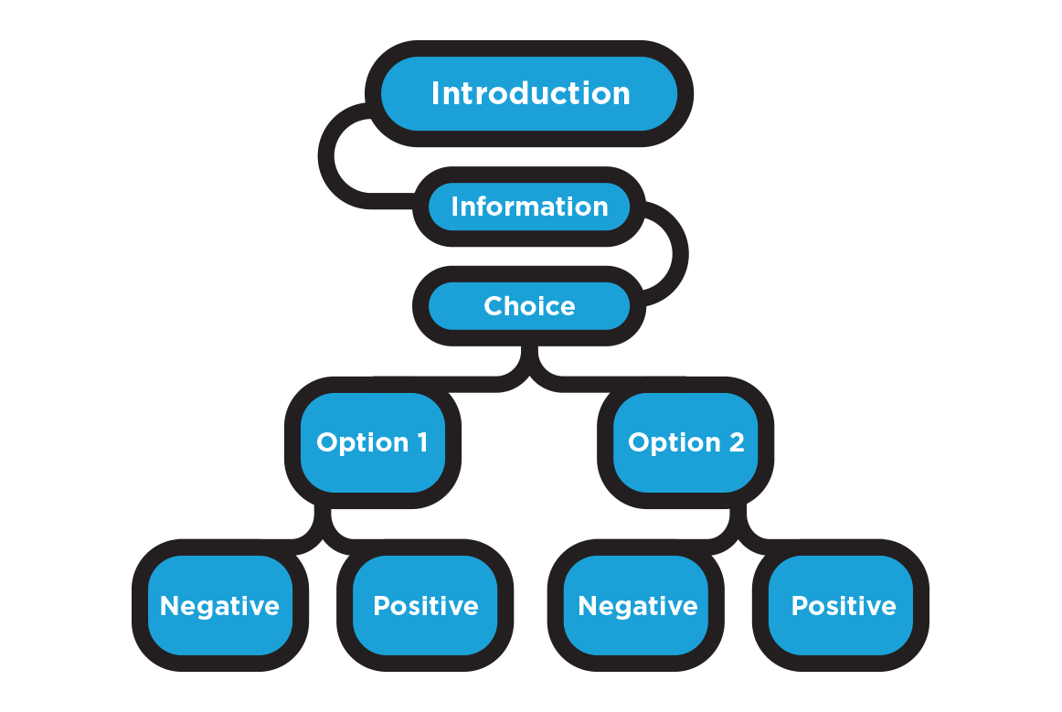
Branching

